Slide 1
SA420-NATURAL RESOURCE ECONOMICS
LECTURER NAME:
MULENGA MPOLOKOSO
(Ph.D_WIP, MBA, BBA, BICTED, BSCFO, TM, ISP, CMP)

Slide 2
TOPIC 4: INVESTMENT FINANCIAL ANALYSIS
OUTLINE OF THE TOPIC
Concept of Interest Rate
Components of Interest Rate
Simple Vs Compound Interest Rate (Effect of Compound Interest And Time)
Basics of Compounding And Discounting (Calculating Future And Present Values of Single Sum)
Rate of Return And Discounted Cash Flow Method
Present value of perpetual annual and periodic series
Present value of terminating annual and periodic series
Sinking fund and capital recovery

Slide 3
Concept of Interest Rate
What are interest rates?
Interest rates are prices for loanable funds – that is:
Prices of funds invested, lent out or borrowed for various periods.
The supplier or lender of funds normally wants to earn an income and
The user or borrower will generally be prepared to pay for the right to use the accumulated funds.

Slide 4
Components of Interest Rate
Using the concept of present value, the yield to maturity on a simple loan is easy to calculate.
For the one-year loan we discussed, today’s value is $100, and the payments in one year’s time would be $110 (the repayment of $100 plus the interest payment of $10).
We can use this information to solve for the yield to maturity i by recognizing that the present value of the future payments must equal today’s value of a loan.
Making today’s value of the loan ($100) equal to the present value of the $110 payment in a year (using PV = FV/ (1 +i )^n) gives us: $100 = $110 /(1 +i)^1. Solve for I = 10%

Slide 5
Simple Vs Compound Interest Rate (Effect of Compound Interest And Time)
Let’s look at the simplest kind of debt instrument, which we will call a simple loan. In this loan, the lender provides the borrower with an amount of funds (called the principal) that must be repaid to the lender at the maturity date, along with an additional payment for the interest.
For example, if you made your friend, Jane, a simple loan of $100 for one year, you would require her to repay the principal of $100 in one year’s time along with an additional payment for interest; say, $10.
In the case of a simple loan like this one, the interest payment divided by the amount of the loan is a natural and sensible way to measure the interest rate.
This measure of the so called simple interest rate, i,= PRT. Note rate is in decimals or I = PRT/100

Slide 6
Generally, the formula will be…
PV= FV/ (1+ i )^n
As an example of how the present value concept can be used, let’s assume that you just hit the $20 million jackpot in the New York State
Lottery, which promises you a payment of $1 million for the next twenty years.
You are clearly excited, but have you really won $20 million? No, not in the present value sense. In today’s dollars, that $20 million is worth a lot less.
If we assume an interest rate of 10% as in the earlier examples, the first payment of $1 million is clearly worth $1 million today, but the next payment next year is only worth $1 million/(1+ 0.10) $909,090, a lot less 0.10)2 than $1 million. The following year the payment is worth $1 million/(1 $826,446 in today’s dollars, and so on

Slide 7
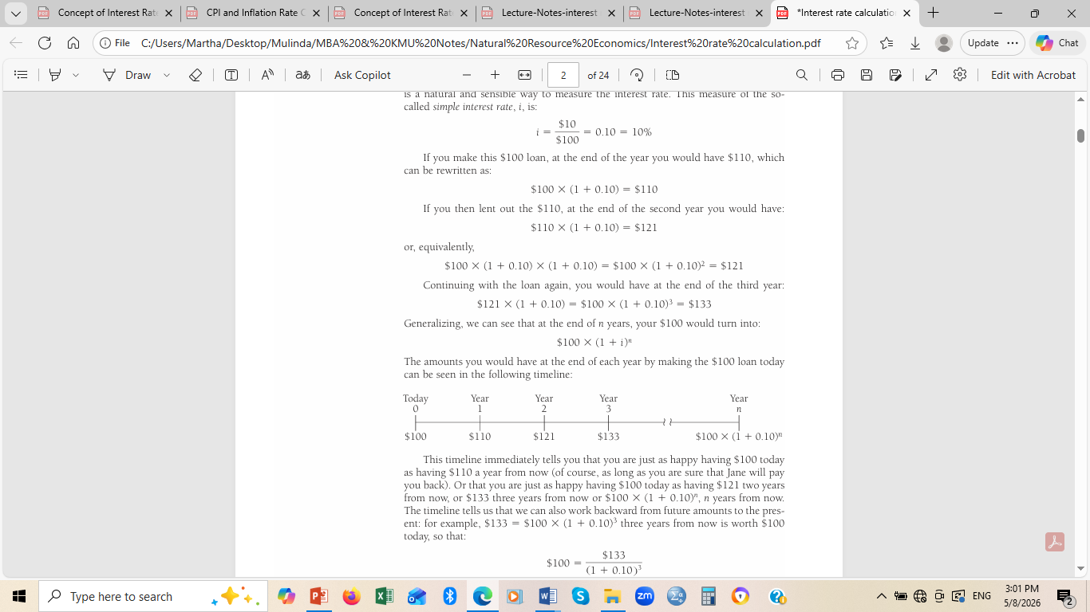

Slide 8
In terms of the timing of their payments, there are four basic types of credit market instruments.
1. A simple loan, which we have already discussed, in which the lender provides the borrower with an amount of funds, which must be repaid to the lender at the maturity date along with an additional payment for the interest.
Many money market instruments are of this type: for example, commercial loans to businesses.

Slide 9
Cont..
2. A fixed-payment loan (which is also called a fully amortized loan) in which the lender provides the borrower with an amount of funds, which must be repaid by making the same payment every period (such as a month), consisting of part of the principal and interest for a set number of years.
For example, if you borrowed $1,000, a fixed-payment loan might require you to pay $126 every year for 25 years. Installment loans (such as auto loans) and mortgages are frequently of the fixed-payment type.

Slide 10
CONT..
3. A coupon bond pays the owner of the bond a fixed interest payment (coupon payment) every year until the maturity date, when a specified final amount (face value or par value) is repaid.
The coupon payment is so named because the bond holder used to obtain payment by clipping a coupon off the bond and sending it to the bond issuer, who then sent the payment to the holder.
Nowadays, it is no longer necessary to send in coupons to receive these payments.
A coupon bond with $1,000 face value, for example, might pay you a coupon payment of $100 per year for ten years, and at the maturity date repay you the face value amount of $1,000. (The face value of a bond is usually in $1,000 increments.)

Slide 11
A coupon bond is identified by three pieces of information.
First is the corporation or government agency that issues the bond.
Second is the maturity date of the 64 PART II Financial Markets bond.
Third is the bond’s coupon rate, the dollar amount of the yearly coupon payment expressed as a percentage of the face value of the bond.
In our example, the coupon bond has a yearly coupon payment of $100 and a face value of $1,000.
The coupon rate is then $100/$1,000 = 0.10, or 10%.
Capital market instruments such as U.S. Treasury bonds and notes and corporate bonds are examples of coupon bonds

Slide 12
CONT…
4. A discount bond (also called a zero-coupon bond) is bought at a price below its face value (at a discount), and the face value is repaid at the maturity date.
Unlike a coupon bond, a discount bond does not make any interest payments; it just pays off the face value.
For example, a discount bond with a face value of $1,000 might be bought for $900; in a year’s time the owner would be repaid the face value of $1,000.
U.S. Treasury bills, U.S. savings bonds, and long-term zero-coupon bonds are examples of discount bonds.

Slide 13
Basics of Compounding And Discounting (Calculating Future And Present Values of Single Sum)
These four types of instruments require payments at different times: Simple loans and discount bonds make payment only at their maturity dates,
Whereas fixed-payment loans and coupon bonds have payments periodically until maturity.
How would you decide which of these instruments provides you with more income?
They all seem so different because they make payments at different times.
To solve this problem, we use the concept of present value, explained earlier, to provide us with a procedure for measuring interest rates on these different types of instruments.

Slide 14
Simple Loan. Using the concept of present value, the yield to maturity on a simple loan is easy to calculate.
For the one-year loan we discussed, today’s value is $100, and the payments in one year’s time would be $110 (the repayment of $100 plus the interest payment of $10).
We can use this information to solve for the yield to maturity i by recognizing that the present value of the future payments must equal today’s value of a loan.
Making today’s value of the loan ($100) equal to the present value of the $110 payment in a year (using Equation 1) gives us: $100 = $110 /(1+ i) Solving for i, i = ($110 - $100 )/$100 =$10 /$100 = 0.10 OR 10%

Slide 15
CONT..
An important point to recognize is that for simple loans, the simple interest rate equals the yield to maturity.
Hence the same term i is used to denote both the yield to maturity and the simple interest rate.

Slide 16
Fixed-Payment Loan
To calculate the yield to maturity for a fixed-payment loan,
We follow the same strategy we used for the simple loan—
We equate today’s value of the loan with its present value.
Because the fixed-payment loan involves more than one payment, the present value of the fixed-payment loan is calculated as the sum of the present values of all payments (using Equation 1).
In the case of our earlier example, the loan is $1,000 and the yearly payment is $126 for the next 25 years.
The present value is calculated as follows:

Slide 17
CONT…
In the case of our earlier example, the loan is $1,000 and the yearly payment is $126 for the next 25 years.
The present value is calculated as follows:
At the end of one year, there is a $126 payment with a PV of $126/(1+i),there is another $126 payment with a PV of $126/(1+ i);
At the end of two years, there is another $126 payment with a PV of $126/(1+ i)^2; and so on until at the end of the twenty-fifth year, the last payment of $126 with a PV of $126/(1+ i)^25 is made. Making today’s value of the loan ($1,000) equal to the sum of the present values of all the yearly payments gives us:

Slide 18
CONT…
$1,000 =$126 /(1 +i) + $126 /(1 +i )^2 + $126 /(1 +i )^3 +……+ $126 /(1 +i )^25
More generally, for any fixed-payment loan,
LV = FP /(1+ i) + FP/(1 + i )^2 + FP/(1 + i )^3 +…..+FP /(1+ i )^n
Where; LV = loan value
FP = fixed yearly payment
n = number of years until maturity

Slide 19
CONT…
For a fixed-payment loan amount, the fixed yearly payment and the number of years until maturity are known quantities, and only the yield to maturity is not.
So we can solve this equation for the yield to maturity i. Because this calculation is not easy, many pocket calculators have programs that allow you to find i given the loan’s numbers for LV, FP, and n.
For example, in the case of the 25-year loan with yearly payments of $126, the yield to maturity that solves Equation 2 is 12%.
Real estate brokers always have a pocket calculator that can solve such equations so that they can immediately tell the prospective house buyer exactly what the yearly (or monthly) payments will be if the house purchase is financed by taking out a mortgage

Slide 20
Rate of Return And Discounted Cash Flow Method
Example on DCF
Estimate the value of the equity of a firm using the DCF method. Assume the firm has the following cash flows to equity for the next five years:
Year 1: $80
Year 2: $90
Year 3: $110
Year 4: $130
Year 5: $150
The cost of equity is 12.5%, and the firm can borrow long-term at 9% (pre-tax). The tax rate for the firm is 40%.
Assume a perpetual growth rate of 2 percent after year 5.
Show your calculations

Slide 21
SOLUTIONS
To estimate the value of the equity of the firm using the Discounted Cash Flow (DCF) method, follow these steps:
1.Calculate the present value of the cash flows to equity for each year.
2.Determine the terminal value of equity at the end of Year 5.
3.Discount the terminal value of equity to its present value.
4.Add the present values of the cash flows and the terminal value to find the total value of equity.

Slide 22
Present Value of Cash Flows to Equity:
Year 1: PV1 = $80 / (1 + 0.125)^1 = $71.11
Year 2: PV2 = $90 / (1 + 0.125)^2 = $71.11
Year 3: PV3 = $110 / (1 + 0.125)^3 = $77.26
Year 4: PV4 = $130 / (1 + 0.125)^4 = $81.16
Year 5: PV5 = $150 / (1 + 0.125)^5 = $83.24

Slide 23
Terminal Value:
Using the perpetuity growth model: TV = (CF5 × (1 + g)) / (r - g)
CF5 = Cash flow in Year 5 = $150
g = Long-term growth rate (assumed to be 2%)
r = Cost of equity = 12.5%
TV = ($150 × (1 + 0.02)) / (0.125 - 0.02) = $1,436.36
Discounting Terminal Value and Cash Flows:
Discounted Terminal Value = $1,457.14 / (1 + 0.125)^5 = $808.61
Total Discounted Cash Flows = PV1 + PV2 + PV3 + PV4 + PV5 =

Slide 24
Calculate Equity Value:
Equity Value = Discounted Terminal Value + Total Discounted Cash Flows
= $808.61 + $383.86
= $1192.47
Therefore, the estimated value of the equity of the firm using the DCF method is approximately $1,192.47.

Slide 25
PRACTICE QUESTION
A business is due K10,000 from a customer and a customer has agreed to make the payment in 90days time. The business approaches a debt factor who agrees to pay the amount due now less a discount rate of 10%, calculate;
A) The discount charged
B) What interest rate does the discount charged represent?
Solution:
Apply Simple Interest formula payable on monthly basis to calculate the discount factor: DF = Amount Due*Rate*Time (In days)

Slide 26
Solution Continues
Discount Factor (DF) = 10,000*10%*(90/365)
DF =K246.58
What is the Amount (A) to be paid? 10,000 – 246.58 = K9,753.42
B) The debt factor will pay the business K10,000 less K246.58 which is K9,753.42.
However K246.58 does not represent a charge based on the amount of the advance (K9,753.42). Rather, it is based on the higher original amount of the customer’s debt of K10,000. As a proportion of K9,753.42 advanced by the debt factor, K246.58 represents an interest rate of 10.25%. Calculated as r = DF/(A+T) = 246.58/(9,753.42*(90/365) = 10.25%

Slide 27
Present value of perpetual annual and periodic series
CONSTANT PERPETUITIES (ANNUAL VS PERIODIC)
When equal fixed amount is paid at regular intervals forever, this is a standard constant perpetuity. The frequency of the payments determines whether it is annual (paid once a year) or periodic (paid multiple times a year, like monthly or quartery.
Formula: PV = C/r. where PV is present value, C = Cash Flow (Payment amount) and r = Discount rate the required rate of return or interest rate expressed as a decimal.

Slide 28
Examples
Annual Series: Imagine you want to endow an annual university scholarship that awards K5,000 every year forever. If the discount (interest) rate is 6% (0.06), the present value (Amount you need to deposit today is?
PV = K5,000/0.06 = K83,333.33
Periodic (Monthly) series: A trust fund guarantees you a payout of K1000 per month forever, Assuming an annual discount rate of 12%,. Calculate the present value .
Solution: PV = K1000/(0.12/12) = K100,000 interest is reduced to monthly.

Slide 29
Present value of terminating annual and periodic series
PV of terminating cash flows represent the current worth of finite sequence of furture payments, discounted at a specific interest rate.
These series gradually falls into categories:
Annual cash flows and periodic cash flows.
Terminating Annual Series (Ordinary Annuity)
Here annual series involves equal payments made at the end of each year for a fixed number of years.

Slide 30
Formula.
PV = PMT x [(1-(1+r)^-n))/r]
Where PV is present value.
PMT is Annual Payment
R is interest rate (as decimal)
n is Total Number of Years.
Example: You are promised an annual payout from your timber investment project of $5000 at the end of the year each year for 4 years. If the annual discount rate is 6%, what is the series worth to you today?

Slide 31
Solutions
PMT = 5000
r = 0.06
n=4
PV = 5000 X [(1-(1+0.06)^-4)/0.06]
PV = 5000 x [(1-0.792094)/0.06]
PV = 5000 x 3.465106
PV = 17,325.53.

Slide 32
PERIODIC
A periodic series involves equal payments made multiples times
Formula:
Payments occur m times per year.
FORMULA
PV = PMT x [(1-(1+r/m)^-(n x m))/r/m]
Where; PMT = Periodic Payment Amount
r = Annual interest rate (nominal rate)
m = Number of compounding periods per year
n = Total Number of Years.

Slide 33
EXAMPLE
You sign a contract to supply farm inputs to Ministry of Agriculture. that pays you K400 every quarter for 3 years. Annual interest rate is 8%. What is the Present Value of this contract?
SOLUTION
PMT=400, r = 0.08, m = 4 months, n = 3 yrs
Rate = r/m = 0.08/12 = 0.02
Total period = 3x 4 = 12
PV [ (1-(1+0.02)^-12)/0.02]
PV = 400 [1-0.788493)/0.02] = 400 x 10.57341 = 4,230.14.

Slide 34
ANNUITY DUE
FORMULA: Multiply the standard formula for ordinary sannuity by (1+r).
PV_due = PV = PMT x [(1-(1+r)^-n))/r] x (1+r)
Example: You rent an office for $5000 per year for 4 years. The rent must be paid at the beginning of each year. If the discount rate is 6%, What is the present value of these lease payments?
PV_due = $5000 x [(1-(1+0.06)^-4))/0.06] x (1+0.06)
PV_due = $5000 x 3.465106 x 1.06
PV_due = $18,365.06.
This is exactly $18,365.06 higher than the ordinary annual annuity example.
For periodic change: r = r/m and n to be n x m. In the same formula.

Slide 35
Sinking fund and capital recovery
A sinking fund is an annuity structured to calculate a predetermined sum of money at the significant future date. In most case it is used by businesses to replace aging machinaery or pay off maturing bonds.
Formula:
PMT = FV x [ r/(1+r)^n – 1]
Example:
An Agricultural company knows it must replace $100,000 tractors in 5 years. They decided to make annual deposits at the end of each year into an account earning 6% interest. How much must they deposit annually?

Slide 36
solution
PMT = 100,000 X [0.06/(1+0.06)^5 -1)]
PMT = 100,000 X [0.06/(1.338226-1)
PMT = 100,000 X 0.177396
PMT = 17,739.64 PER YEAR.

Slide 37
Capital recovery
Capital recovery determines the steady revenue or payment required over a specific timeframe to recoup an initial investment or wipe out a loan balance today. While factoring in the time value of money.
Formula:
PMT = PV x [ (r(1+r)^n)/(1+r)^n – 1)]
Example: A company purchases commercial solar panel grid today for K100,000. The equipment has a lifespan of 5 years. If the company expects an annual discount rate of 6%. What is the uniform annual revenue required to fully recover their initial cost of capital?

Slide 38
SOLUTION
PMT = 100,000 X[ (0.06(1+0.06)^5)/(1+0.06)^5 – 1]
Pmt = 100,000 x [0.080294/0.338226]
PMT = 100,000 x 0.237396
PMT = 23,739.64

